Slide 1
Remotely Close Associations:
Openness to Experience and Semantic Memory Structure
Alexander Christensen Thesis Defense

Slide 2
Why should openness to experience be related to semantic memory?
Openness is highly related to many cognitive attributes: intelligence, working memory, autobiographical memory, implicit memory, insight problem solving, imagination, and creativity
Broad general knowledge: crystallized intelligence, curiosity, love of learning
Cognitive flexibility: divergent thinking, overcoming functional fixedness, diversity of experiences
Creative cognition: creative achievement, remote associates test, metaphor production, humor production, affinity for novelty and uniqueness (originality)
Theoretical reasons: open people have a tendency to seek out, comprehend, and utilize semantic information (DeYoung, 2015)
Empirical reasons: Verb Generation (Prabhakaran et al., 2013) and Essay Response (Kwantes et al. 2016)

Slide 3
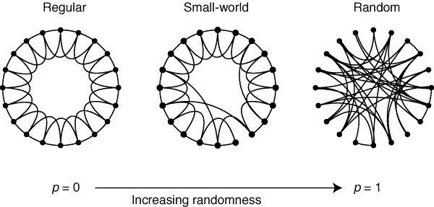

Network Measures
Average Shortest Path Length (ASPL): mean distance between any two nodes in the network
Clustering Coefficient (CC): refers to the extent to which two neighbors of a node will be neighbors themselves
Small-worldness (S): small ASPL and large CC $S= \frac{\frac{CC}{CC (random)}}{\frac{ASPL}{ASPL (random)}}$
Modularity (Q): measure of compartmentalized sections in the network known as network communities
Taken from Watts & Strogatz (1998)

Slide 4
Present Research
Based on openness’s associations with broad general knowledge, cognitive flexibility, and creativity, it’s expected that open people will differ in relation to their semantic structure
It’s also likely that open people will have more individual and unique semantic associations because of their tendency toward novelty, learning, and knowledge

Slide 5
Predictions
DV | Expected Effect (if any) | Interpretation
CC | none | none
ASPL | Negative | As openness increases, networks will become less spread out and more condensed, suggesting increased interconnectivity between associations.
Q | Negative | As openness increases, networks will become less rigid and compartmentalized, suggesting decreased categorization of groupings.
D | Negative | Networks will become more condensed, as openness increases.
S | Positive | As openness increases, networks will be more clustered and have shorter path lengths, which suggests greater flexibility and efficiency between associations.

Slide 6
Method
In total, n = 705 people participated in the current study, collected in three different samples
After removal of inattentive responses and missing data, n = 497 remained
People completed a measure of openness to experience using the NEO-FFI personality inventory (12 items)
People completed a measure of semantic verbal fluency task (i.e., animals; 1 min.)
From the n = 497 people, 3 openness groups of high (SD > .9, n = 115),
moderate (.2 > SD > -.2, n =121), and low (SD < -.9, n = 118) were formed

Slide 7
Analyses
Behavioral: number of individual responses, number of unique responses, early conventional responses, and response frequency proportion
Network: bootstrapped partial networks (1,000 iterations), using 50% of the nodes, were generated to statistically assess differences between groups
Polynomial ANOVAs were used for individual and unique responses, early conventional responses, and all network measures

Slide 8
Behavioral Results
Individual responses: linear, F(1, 963) = 47.64, p < .001, η_{p}² = .05, but no quadratic trend, F(1, 963) = .16, p = .69, η_{p}² = .00
- High (n = 257) was greater than the moderate (n = 221; p = .006) and the low (n = 177; p < .001) openness groups
- Moderate was also greater than low (p < .001)
Unique responses: linear, F(1, 963) = 31.62, p < .001, η_{p}² = .03, but no quadratic trend, F(1, 963) = 1.72, p = .19, η_{p}² = .00
- High (n = 68) had more than the moderate (n = 35) and the low
(n = 21; both p’s < .001) openness groups
- Moderate and the low openness groups did not differ in the number of unique responses (p = .22)

Slide 9
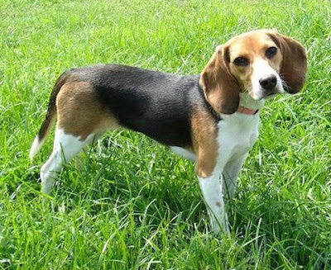
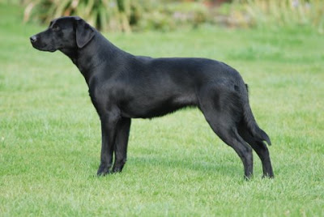
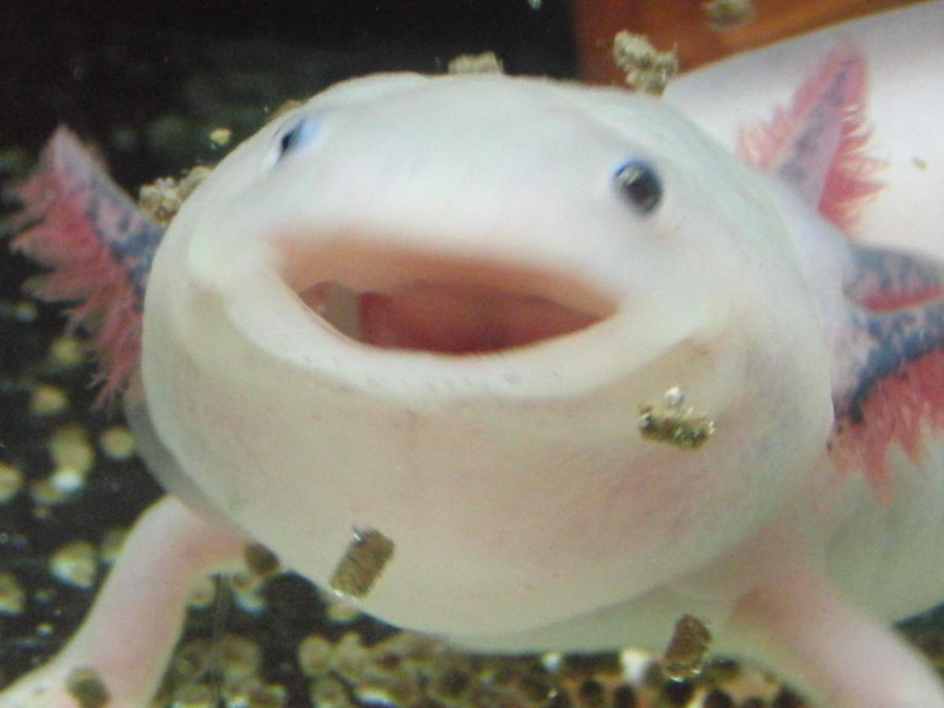
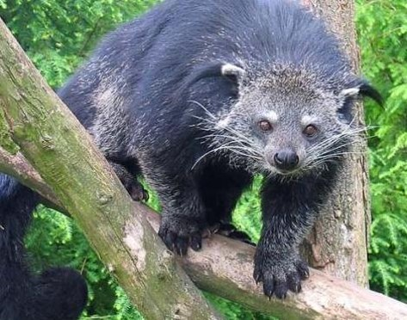
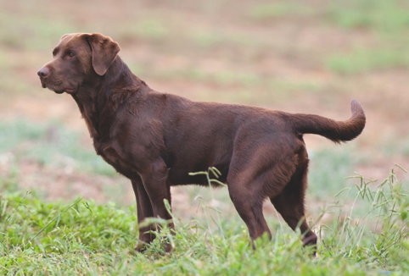
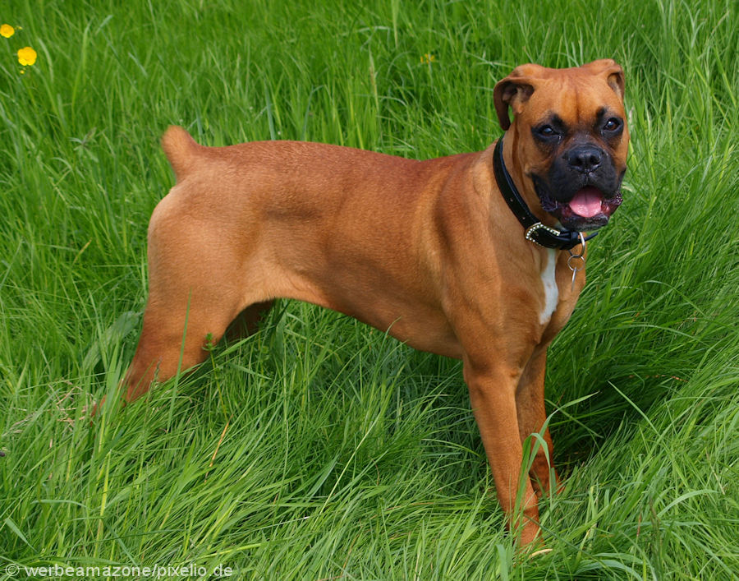
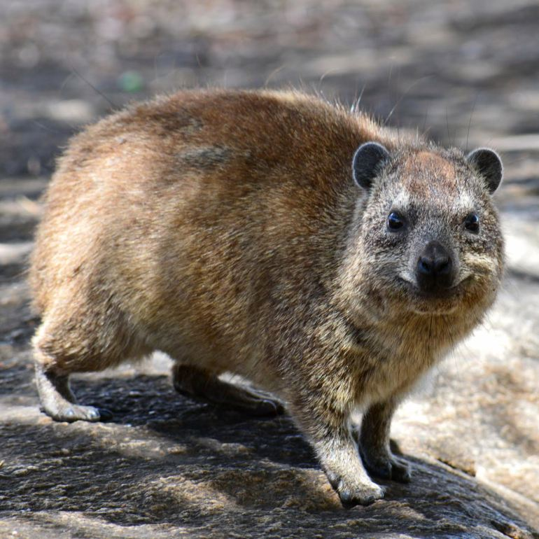
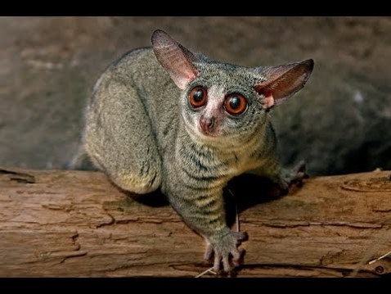
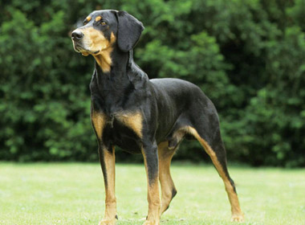
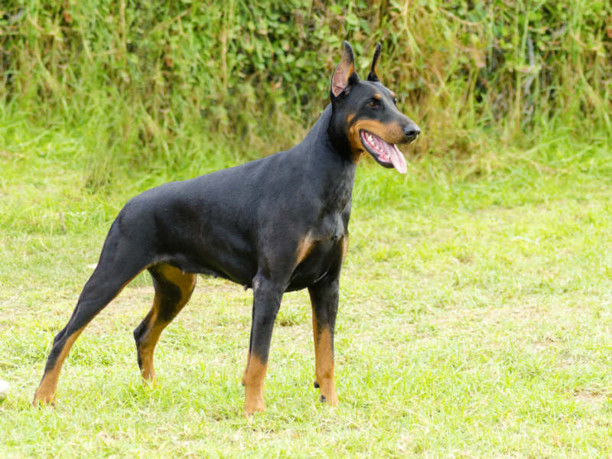
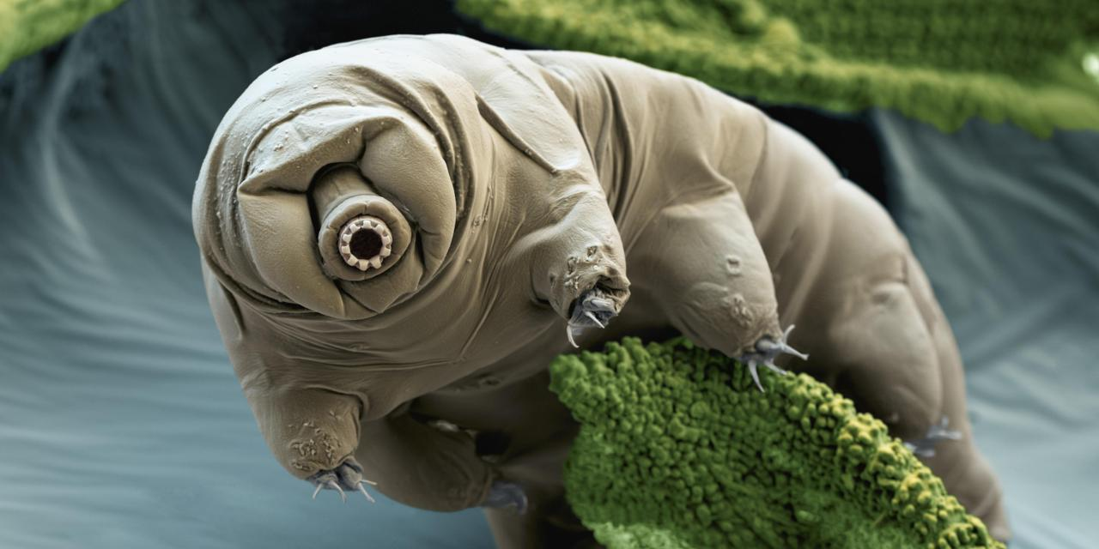
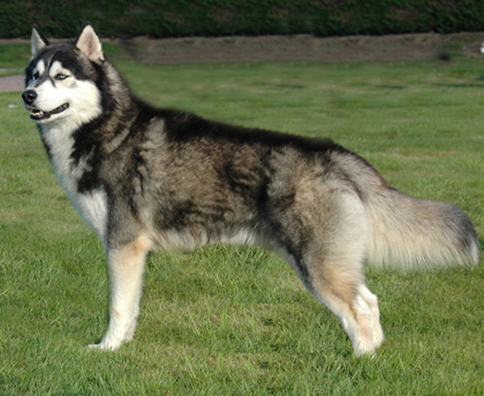
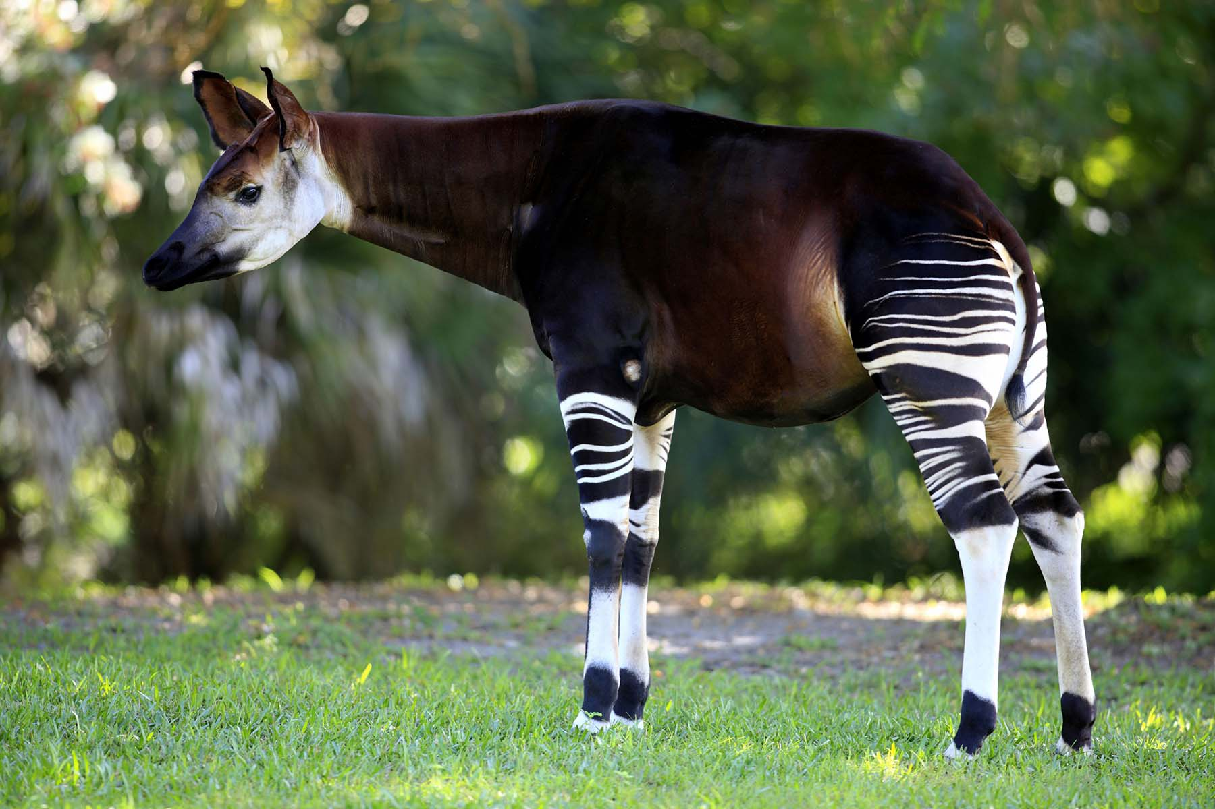
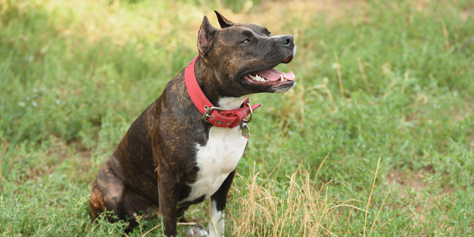
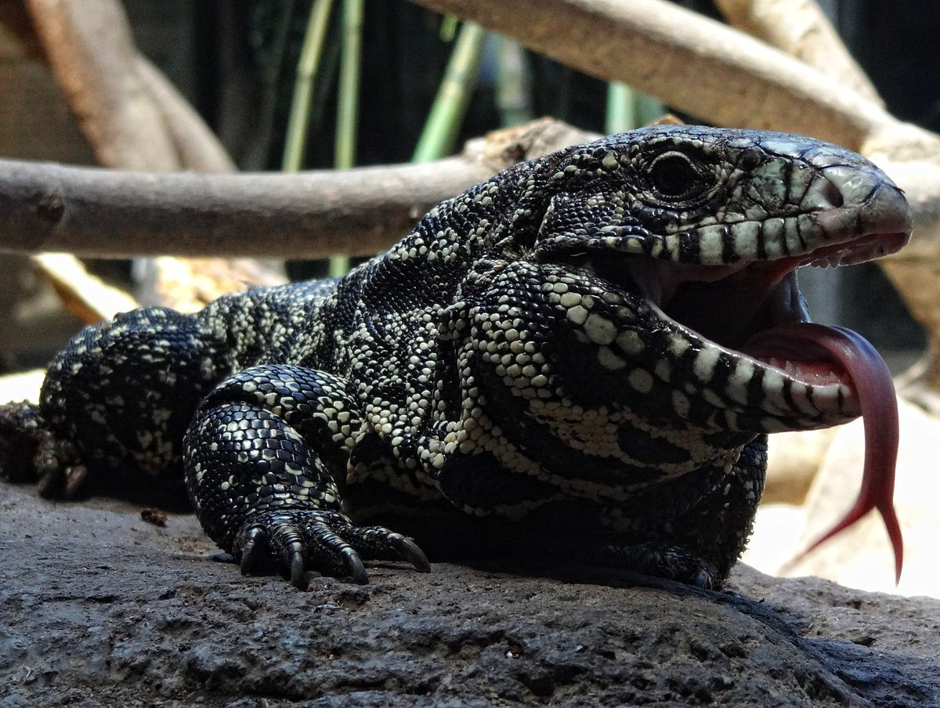
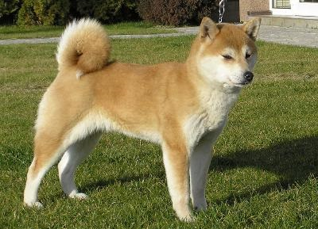
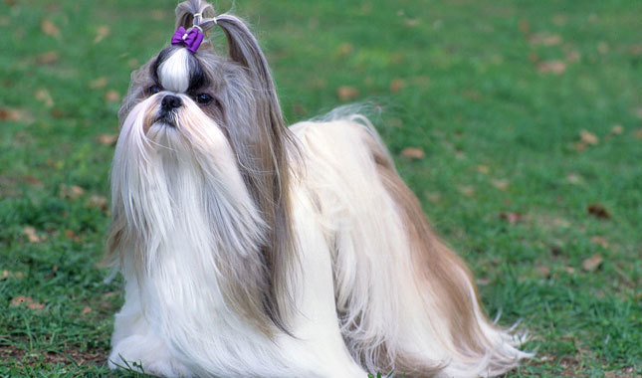
Behavioral Results cont.
Beagle
Axolotl
Black Lab
 | Low | Moderate | High | High Continued
 | Caterpillar | Anaconda | Amoeba | Lory
 | Catfish | Bald Eagle | Angel Fish | Macaw
 | Centaur | Bearded Dragon | Axolotl | Marmoset
 | Fruit Fly | Bearded Lizard | Babel Fish | Okapi
 | Gnat | Black Lab | Badger | Osprey
 | Grouper | Blowfish | Barracuda | Oyster
 | Honey Bee | Bonobo | Beagle | Peacock
 | Hound | Bronco | Binturong | Phoenix
 | Hummingbird | Chocolate Lab | Blue Whale | Pit Bull
 | Kiwi | Dragonfly | Boa Constrictor | Pit Viper
 | Mink | Gibbon | Boxer | Plankton
 | Muskrat | Hornet | Brown Bear | Poison Dart Frog
 | Orca | Husky | Bumblebee | Praying Mantis
 | Reindeer | Komodo Dragon | Capybara | Puffin
 | Reptile | Lion Fish | Cayman | Pygmy Goat
 | Russian Blue | Mammoth | Chickadee | Red Wolf
 | Shih Tzu | Mermaid | Crane | Salmon
 | Sperm Whale | Midge | Cuttlefish | Sand Flea
 | Water Bear | Mountain Hyrax | Deer Mouse | Sea Cucumber
 | Wildcat | Naked Mole Rat | Dik Dik | Sea Horse
 | Wolverine | Pheasant | Dingo | Shiba Inu
 |  | Piranha | Doberman | Shrew
 |  | Red Panda | Dodo | Skink
 |  | Rhesus | Dugong | Small-Mouth Bass
 |  | Sea Sponge | Egret | Snow Leopard
 |  | Sea Urchin | Flea | Sunfish
 |  | Tasmanian Devil | Flying Squirrel | Swordfish
 |  | Tiger Shark | Galago | Tapeworm
 |  | Tuna | Gray Wolf | Tegu
 |  | Water Buffalo | House Fly | Tick
 |  | Whale Shark | Ibis | T-Rex
 |  | Wombat | Jackalope | Wallaby
 |  | Yellow Jacket | Large-Mouth Bass | Weasel
 |  |  | Lop Bunny | White-Tailed Deer
Boxer
Chocolate Lab
Binturong
(Bear Cat)
Mountain Hyrax
Doberman
Galago
Hound
Water Bear
(Tardigrade)
Pit Bull
Husky
Okapi
Tegu
Shiba Inu
Shih Tzu

Slide 10
Behavioral Results cont..
Early Conventional Responses
- 1st response: linear, F(1, 351) = 5.59, p = .019, η_{p}² = .02, and
quadratic, F(1, 351) = 10.53, p = .001, η_{p}² = .03, trends were significant
- High had a significantly lower proportion (.46) than the moderate (.71, p < .001)
and the low openness (.61, p = .049) groups
- Low and moderate did not differ (p = .24)
- 2nd response: quadratic, F(1, 351) = 6.97, p = .009, η_{p}² = .02, but no linear trend,
F(1, 351) = 1.36, p = .24, η_{p}² = .00
- Moderate had a greater proportion (.80) than the high openness group
(.63, p = .013) but not the low openness group (.70, p = .21)
- High and low did not differ (p = .47)
- 3rd response: no trends across the groups

Slide 11
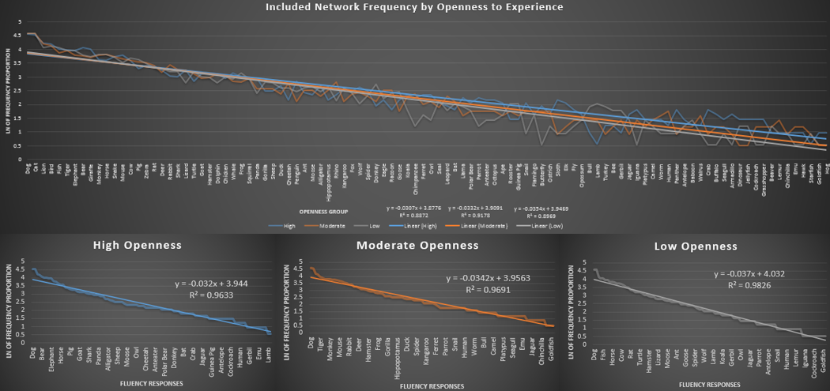
Behavioral Results cont...

Slide 12
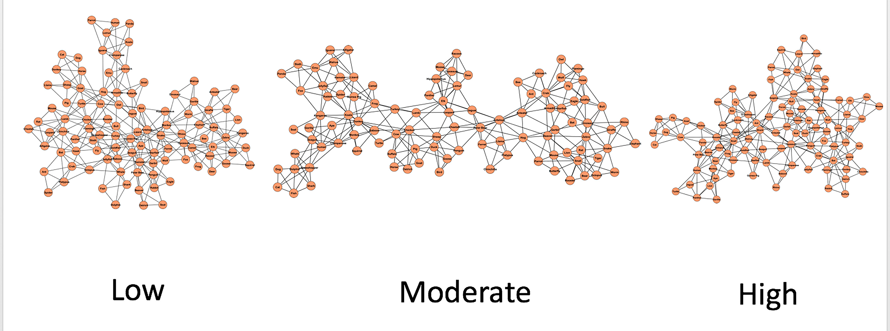
Network Results
Openness Group
Network Measure | Low | Moderate | High
CC | 0.61 | 0.59 | 0.61
ASPL | 3.58 | 4.24 | 3.49
Q | 0.62 | 0.58 | 0.55
S | 9.26 | 8.39 | 9.68
CCrand | 0.05 | 0.05 | 0.05
ASPLrand | 2.76 | 2.75 | 2.74

Slide 13
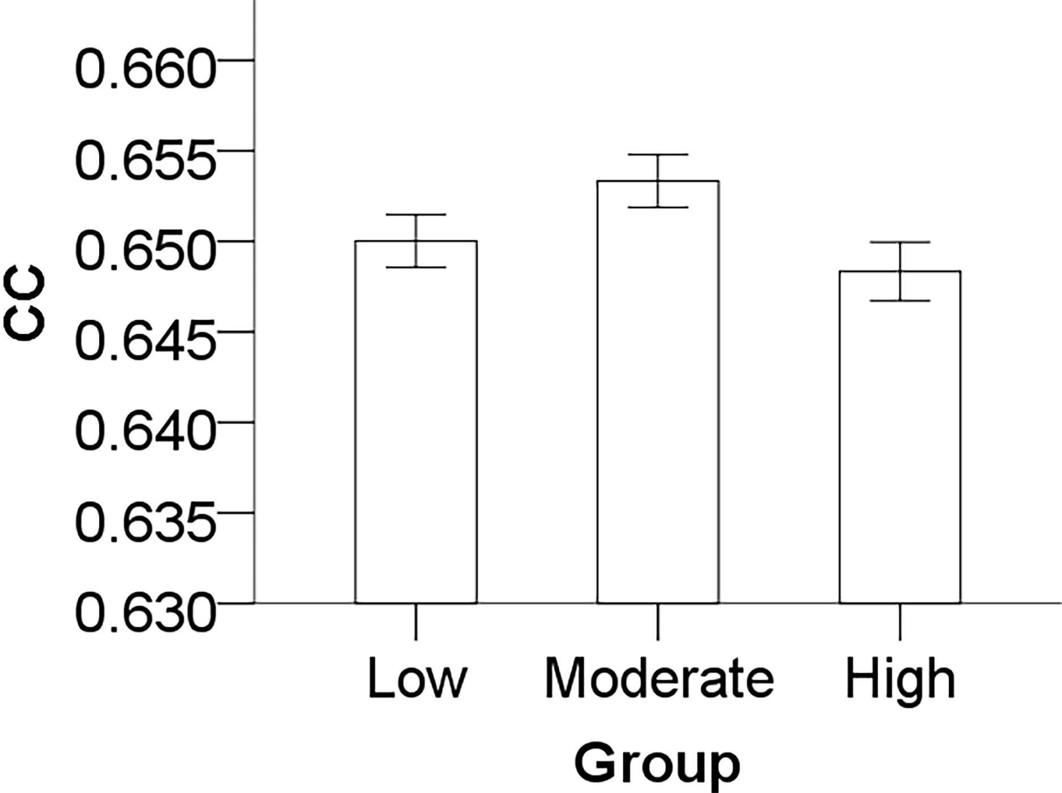
Network Results cont.
CC had a significant quadratic trend, F(1, 2997) = 19.33, p < .001, η_{p}² = .01, but no linear trend, F(1, 2997) = 2.38, p = .12, η_{p}² = .00
- Moderate openness group was significantly larger CC than both the low (p = .007) and the high (p < .001) openness groups
- High did not significantly differ from the low openness group (p = .27)

Slide 14
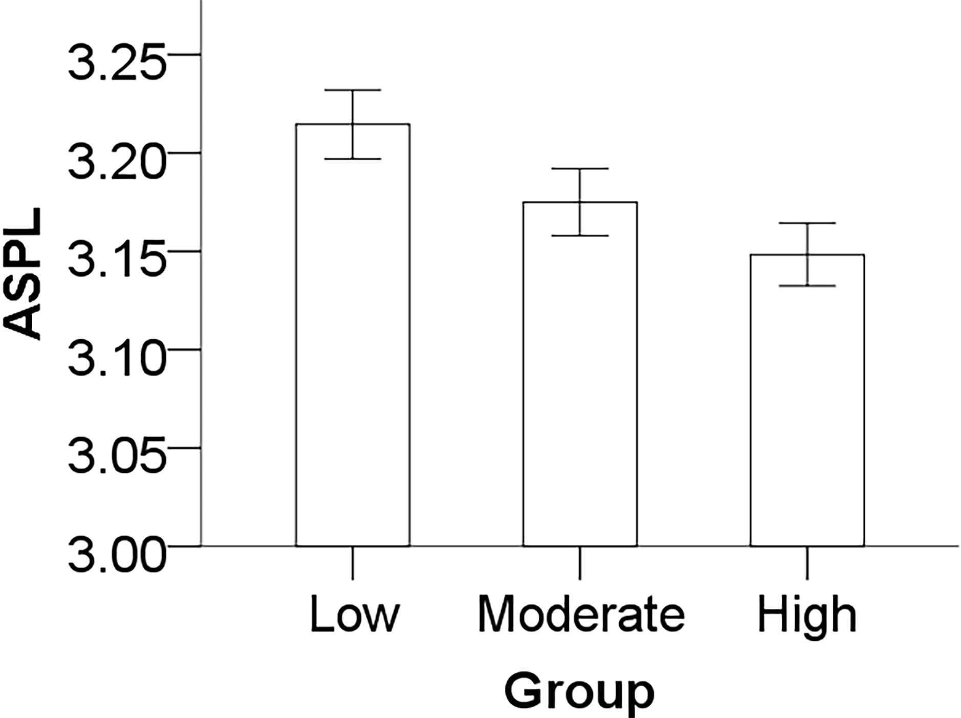
Network Results cont..
Significant linear trend for ASPL, F(1, 2997) = 29.74, p < .001, η_{p}² = .01, but no quadratic trend, F(1, 2997) = .38, p = .54, η_{p}² = .00
High had a significantly smaller ASPL than the low (p < .001) and a marginally smaller ASPL than the moderate openness group (p = .073)
Moderate was significantly smaller than the low openness group (p = .003)

Slide 15
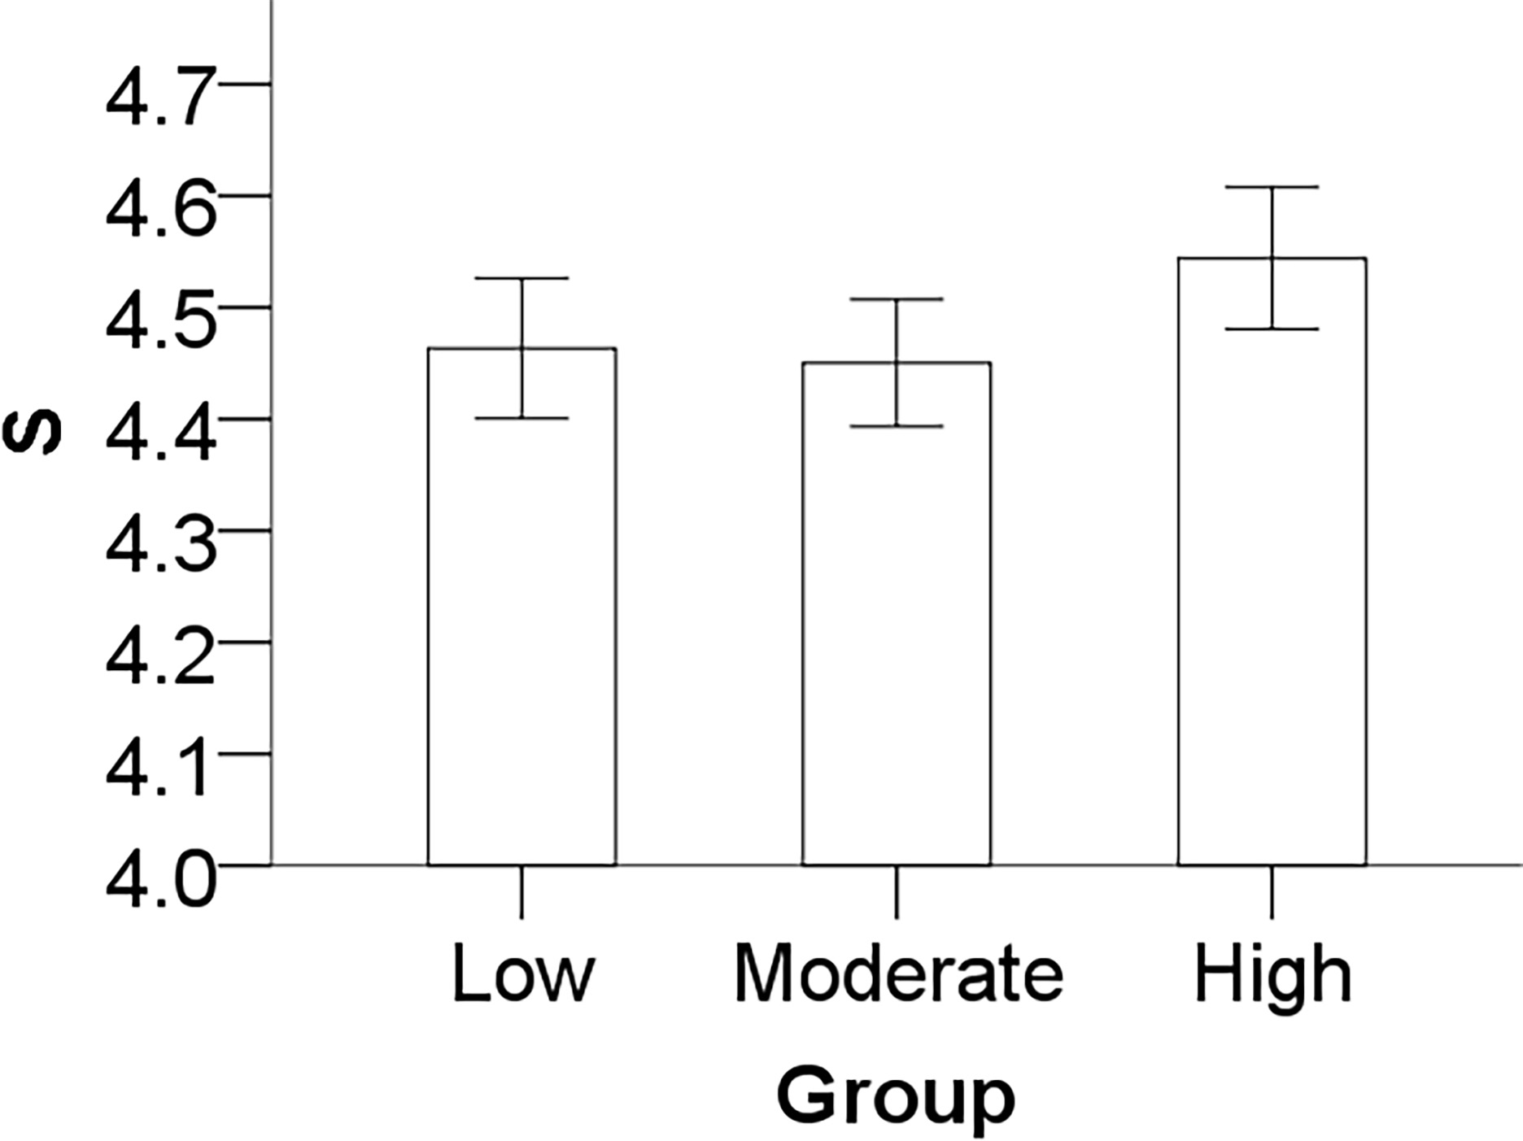
Network Results cont…
S had a marginally significant linear trend, F(1, 2997) = 3.35, p = .067, η_{p}² = .00, but no quadratic trend, F(1, 2997) = 1.96, p = .16, η_{p}² = .00
- High was marginally larger than the moderate openness group (p = .084)
- Low did not differ from the high (p = .16), and the moderate (p = .95)

Slide 16
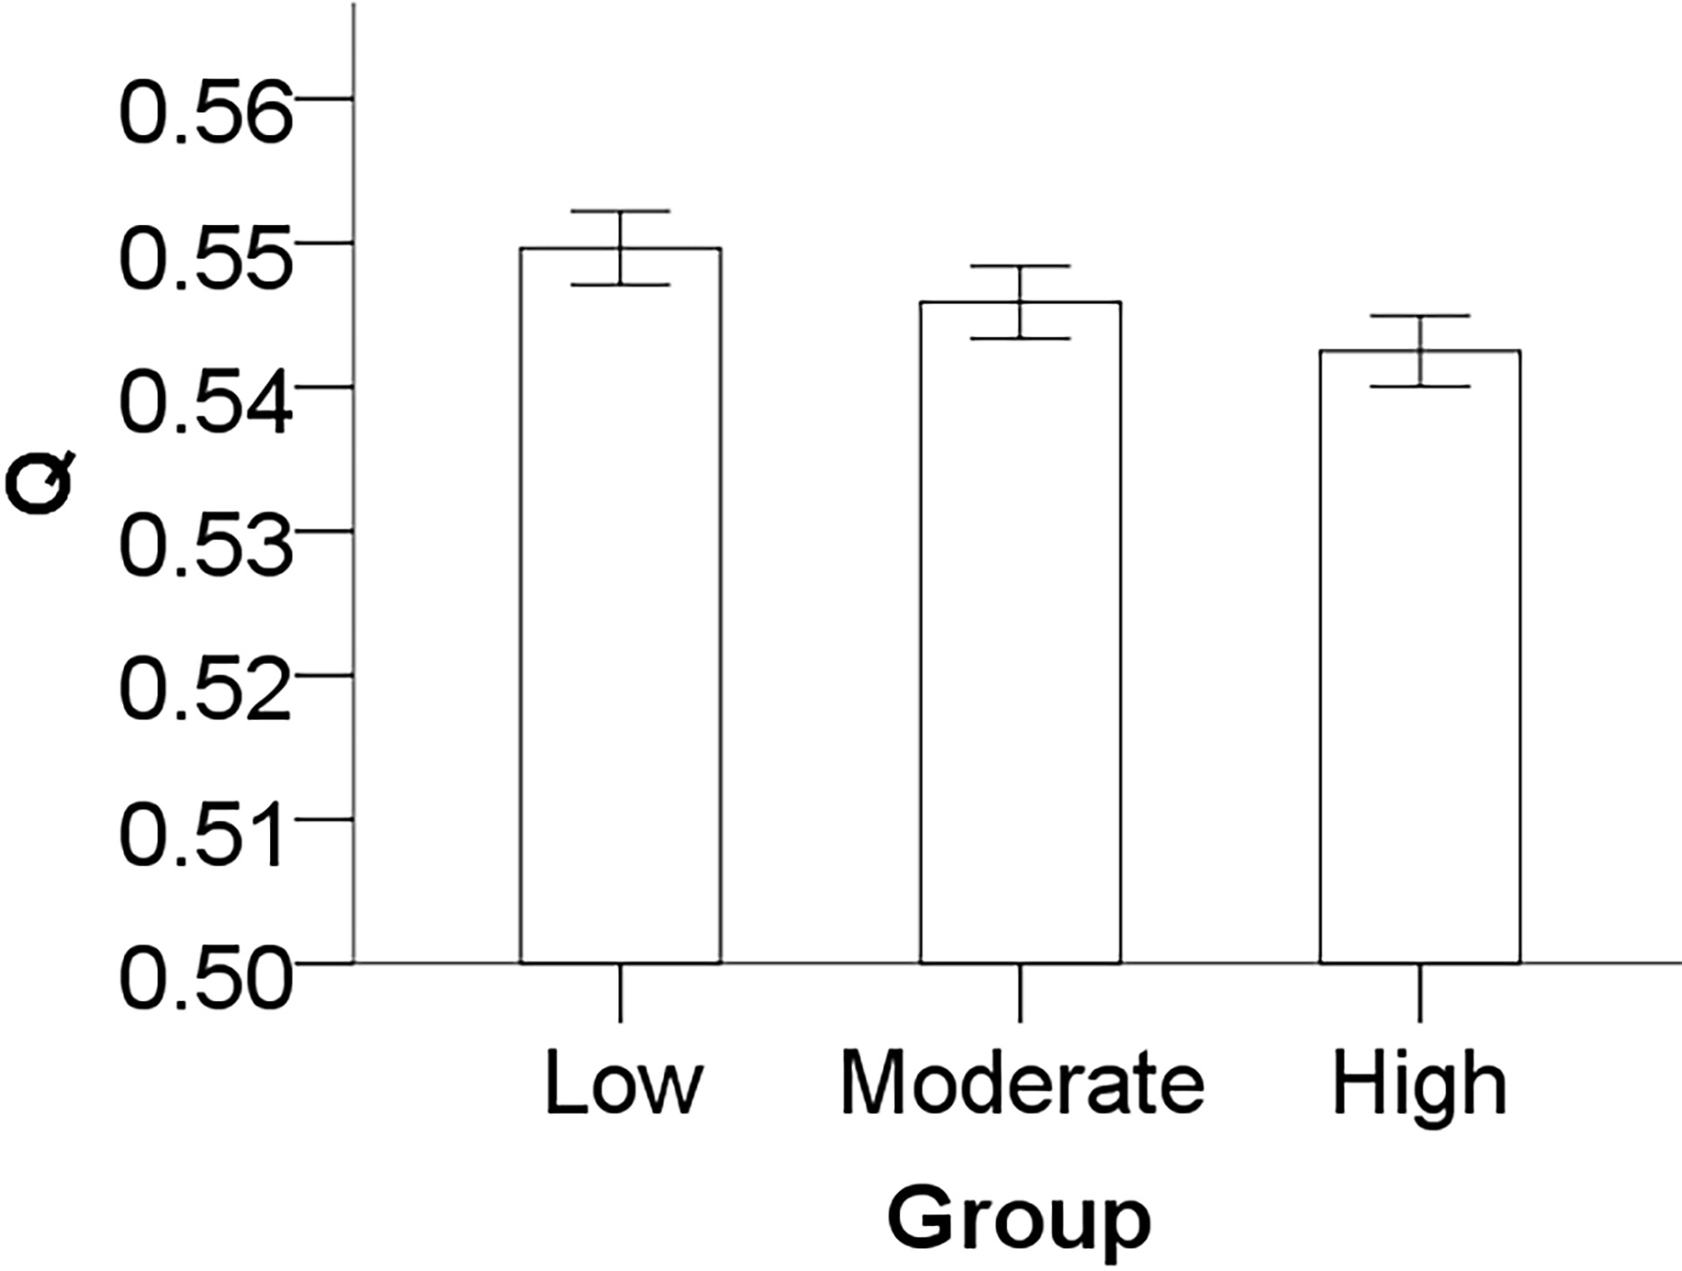
Network Results cont....
Linear trend for Q, F(1, 2997) = 15.72, p < .001, η_{p}² = .01, but no quadratic trend, F(1, 2997) = .02, p = .90, η_{p}² = .00
- High openness was significantly different from the low (p < .001) but not the moderate openness group (p = .15)
- Moderate was marginally smaller than the low group (p =.092)

Slide 17
Summary and Discussion
People higher in openness:
- had more individual and unique responses
- were less likely to start with conventional responses
- had a flatter conceptual frequency proportion slope
- had more flexible (lower Q and larger S) and interconnected semantic networks (smaller ASPL)
The interpretation of CC in semantic networks related to creative cognition is unclear
Full semantic networks did not reflect bootstrapped partial network results
In general, this evidence establishes semantic memory as a foundational cognitive component that underlies the relationship between openness to experience and creativity
Future direction: Examine the semantic network structure of openness to experience’s lower-order aspects—Intellect (associated with fluid intelligence and working memory) and Openness (associated with creative achievement and verb generation distance)

